Slide 1
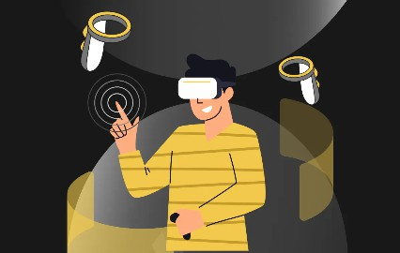
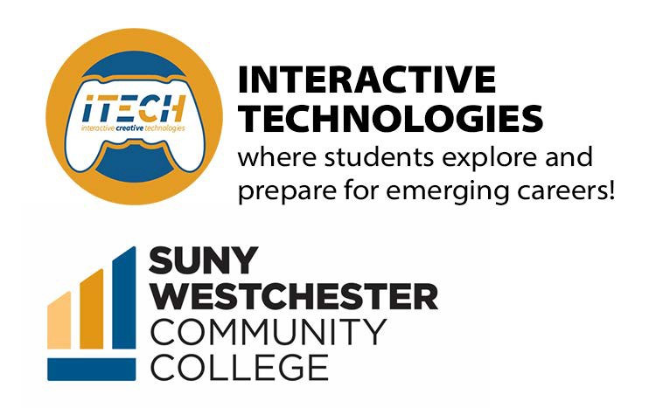
Virtual Reality and
INTERACTIVE Media for Students and Educators

Slide 2

Understanding the USER
UX critical thinking in understanding human behavior
U I design theory creating interfaces the place at which independent and often unrelated systems meet and act on or communicate with each other

Slide 3
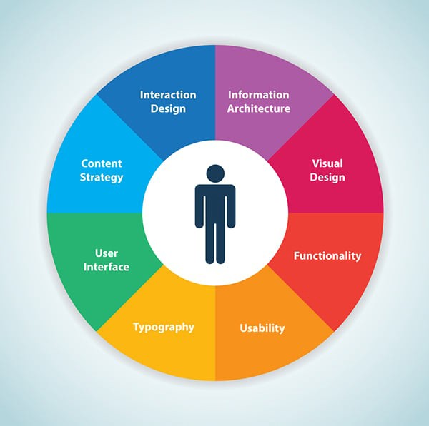
User Experience and Interface applied to
Design Thinking results
Empathise
Define
Ideate
Prototype
Test
Fix and re-test
Update
UX/UI

Slide 4
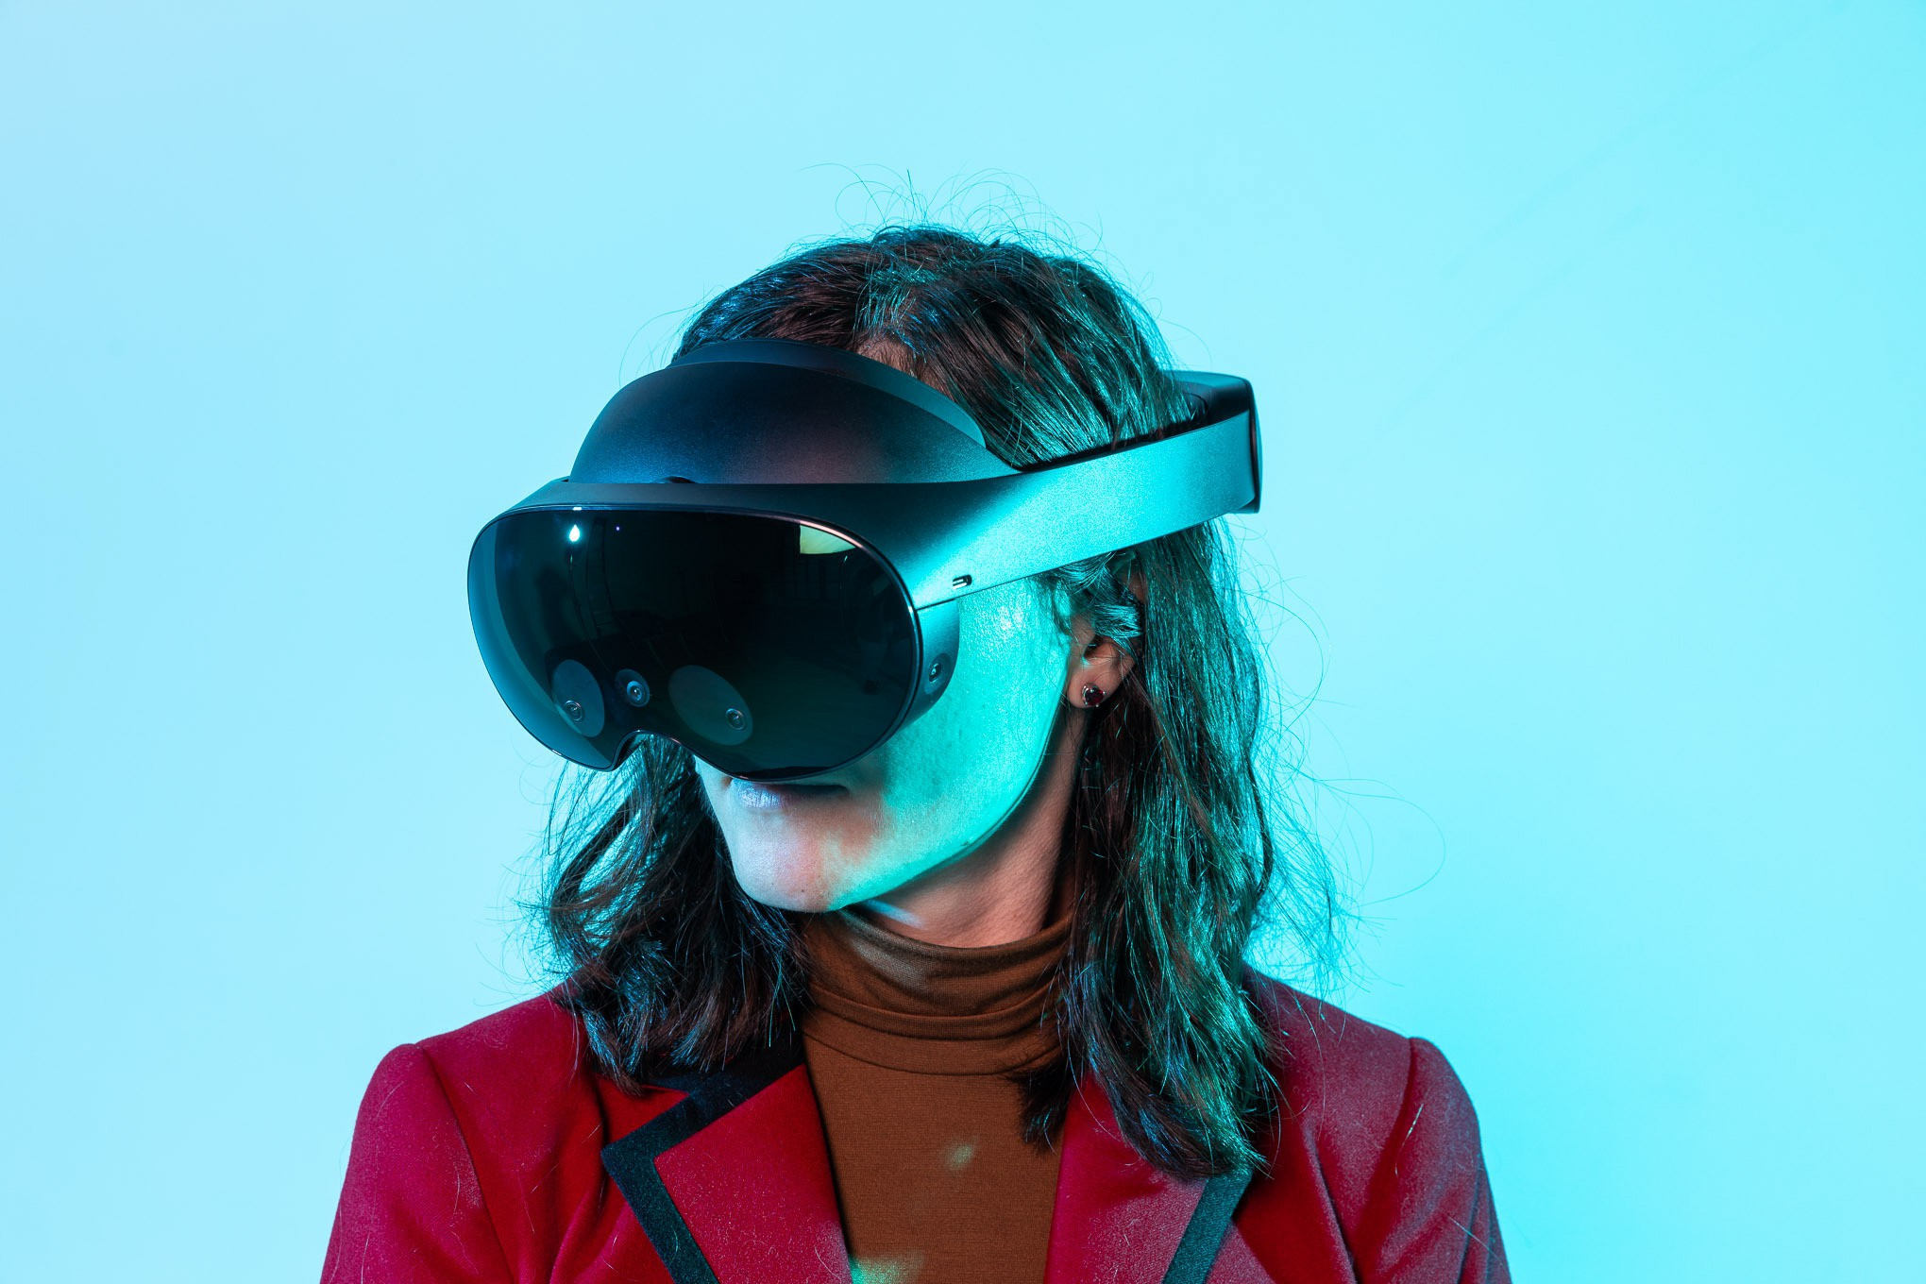
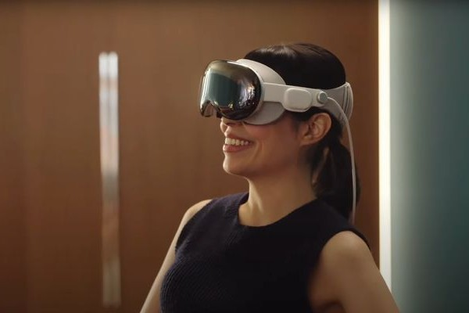
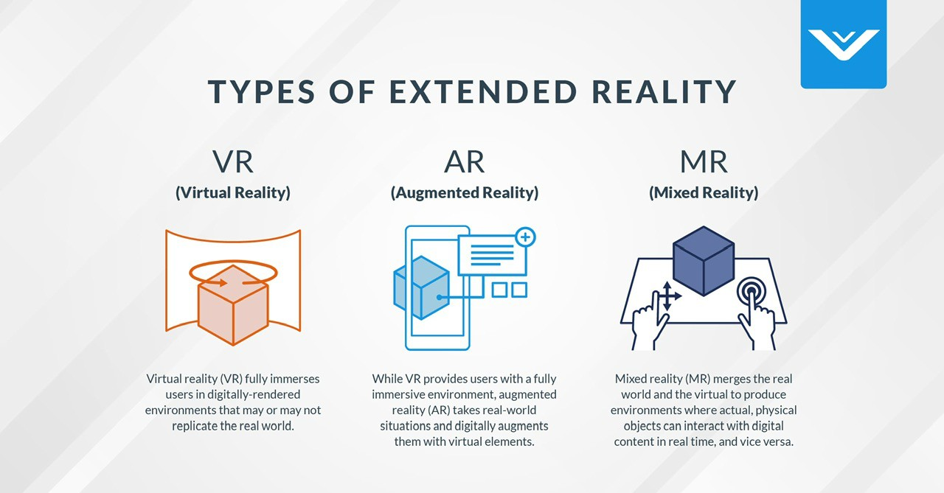
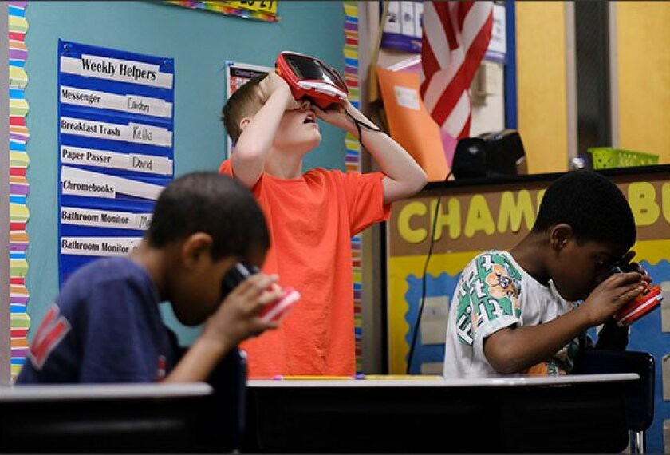
Interactive Media
Extended Reality and Games

Slide 5
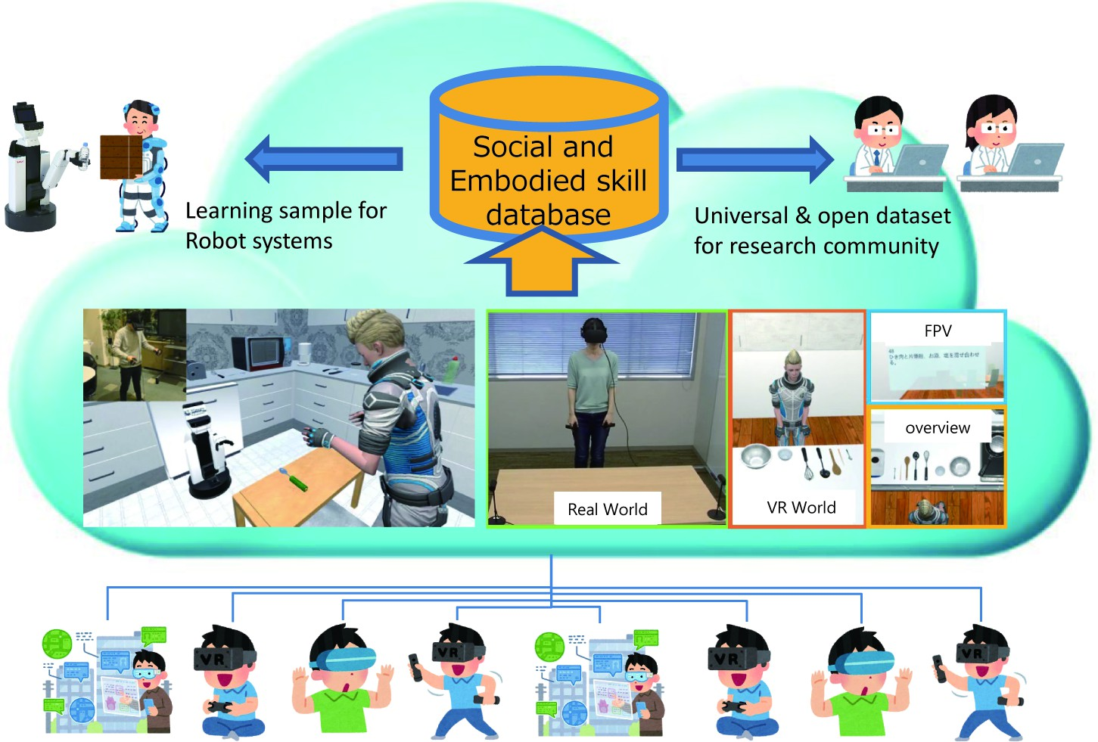
Interactive Media
Extended Reality and Games

Slide 6
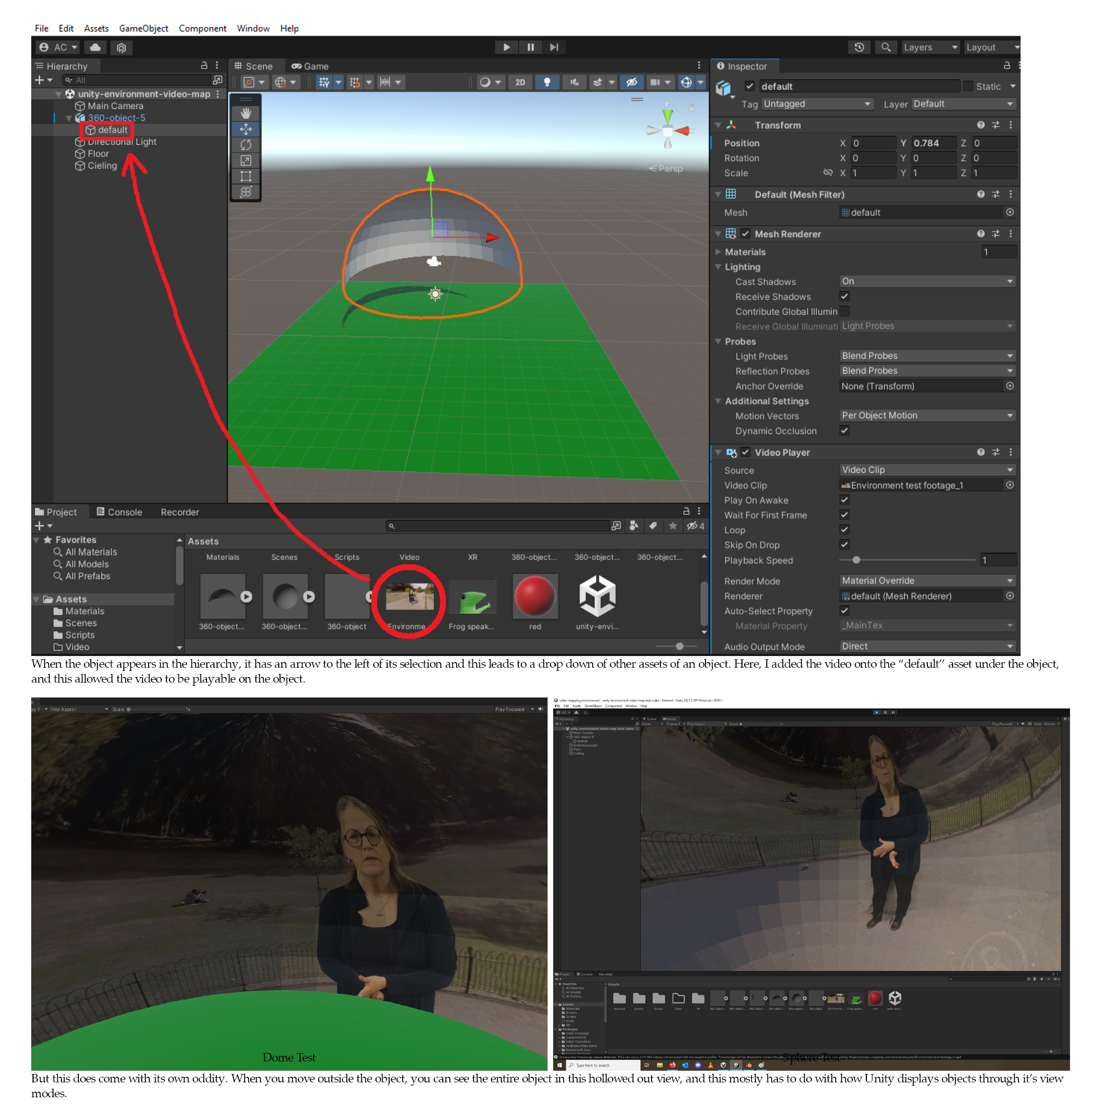
MTA – Spg 23
ITECH 240
New Media Projects
Created VR interactive media for MTA to
train conductors + interactive training materials using Figma or Active Presenter
UNITY and BLENDER,
360 Video Capture . . .

Slide 7
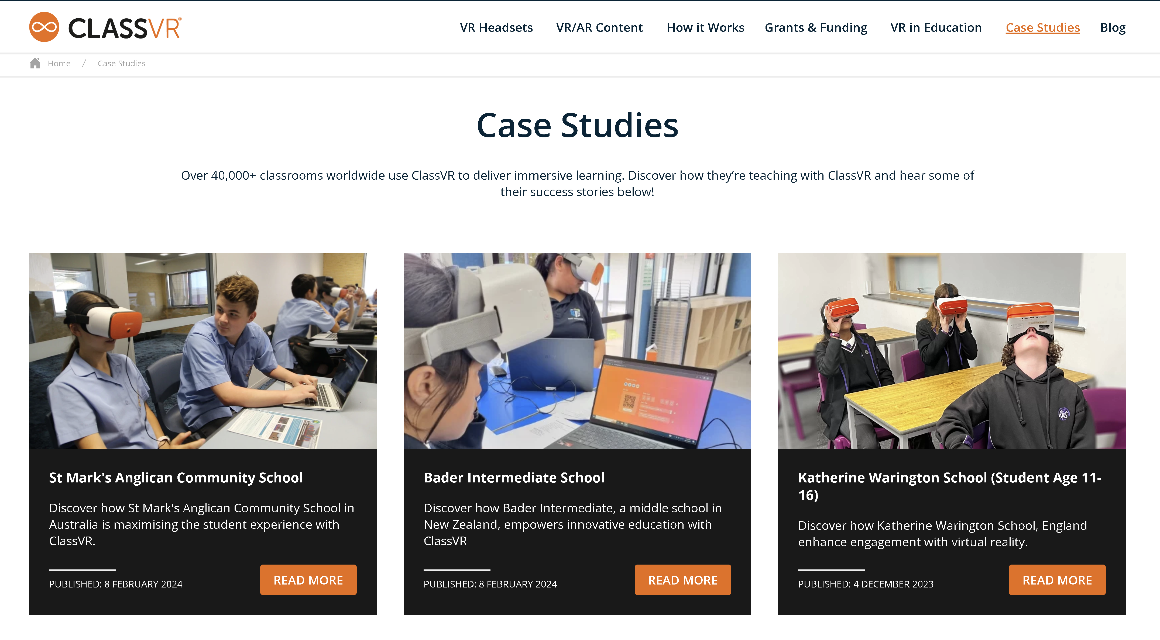
Interactive Media - TOOLS

Slide 8
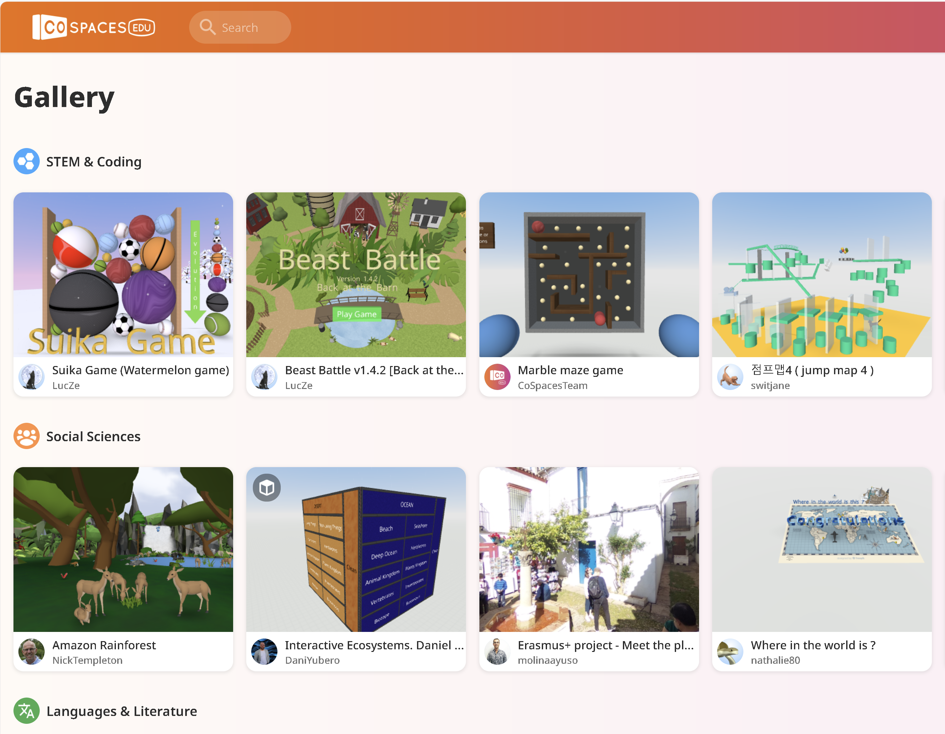
Interactive
Media
Instructional Technologies programs for educators to help facilitate students on how to design and build
VR and games based on existing course materials transformed into interactive experiences.

Slide 9
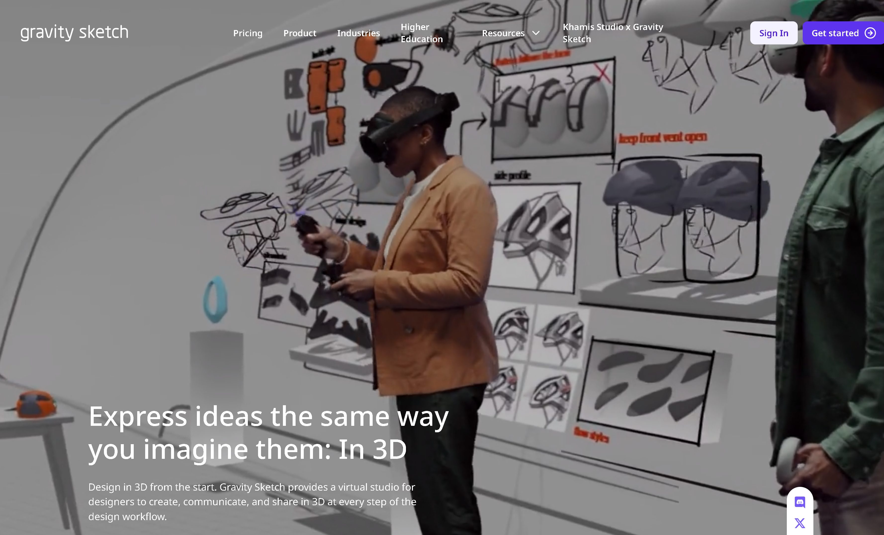
Interactive Media - TOOLS
Gravity Sketch | 3D sketching and design software
Product - Gravity Sketch
Spring 2024 –
New Media Group members (2) were trained by NYIT
to design and build
3D models in
Virtual Reality
– GRAVITY SKETCH tools
QUEST 3 HEADSETS WERE DONATED TO THE STUDENT CLUB

Slide 10
S A N D / T O O L B O X
ACTIVE LEARNING
PERSONALIZED LEARNING
COLLABORATION
FOCUS ON FACILITATORS
CONTINOUS LEARNING
PEDAGOGY FIRST – TOOLS SECOND
EQUITY AND ACCESS
DIGITAL CITIZENSHIP

Slide 11
Thank you
CTL Team!
Spring 2024
Deborah.Krikun@sunywcc.edu

